Slide 1
Angular CLI
Generating Routing Features
Lecture 5
By James(Jin) Wang
09/28/2019

Slide 2
Outline
Adding routing features
Considerations before generating a module
Routing paths to components
Generating guards

Slide 3
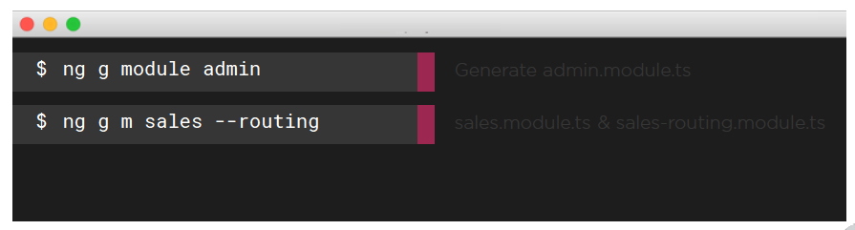
The NgModule Blueprint with Routing
  NgModules and Routing:
  Generate a new NgModule with ng g module <name> <options>
  Define a module and a separate routing module with --routing

Slide 4
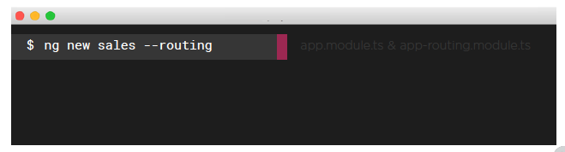
The NgModule Blueprint with Routing
  Generating an App with Routing Features:
  Generate a new NgModule with ng new <app-name> <options>
  Define a separate routing module for the new app with --routing

Slide 5
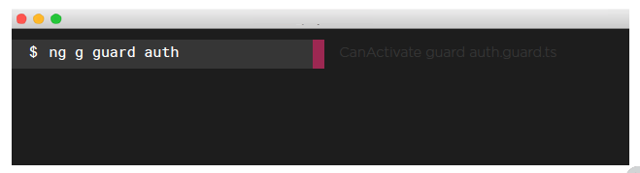
Guards
  Guards:
  Generate a guard for routes
  ng g guard <name>

Slide 6
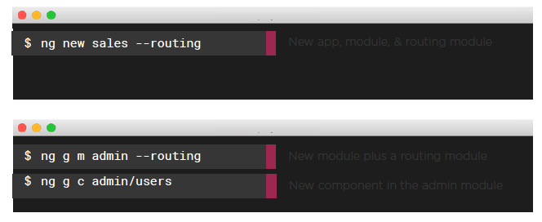
Guards
  Adding Routing Features with the Angular CLI:

Slide 7
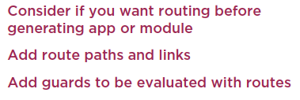
Summary

